Slide 2




Access Control
Controlling access to resources
Minimize risk
Components
Subject
Objects
Privileges
I am…..
Prove it…
Challenged handshake

Slide 3


Access Control Components
Subjects
A user or process
Notes:
Could be Users,
Machines, service accounts fall under the NPE designation

Slide 4


Access Control Components
Objects
Piece of data
Resource

Slide 5



Access Control Components
Privileges
Sometimes called rights
Actions subjects perform on objects
Notes:
Windows will call permissions – the actions taken on or to a resource, while rights are system-wide activities
Linux doesn’t not make this a required distinction
Permission to erase a file vs. the right/privilege to erase the whole disk

Slide 6
Access Control Models
Mandatory Access Control (MAC)
Discretionary Access Control (DAC)
Role-based Access Control (RBAC)
Rule-based Access Control (RBAC)
Attribute-based Access Control (ABAC)

Slide 7

Mandatory Access Control (MAC)
Subject
Object
(Access Level)
(Sensitivity Label)
Secret
Secret Clearance
Top-secret
Notes:
Restricts access to objects based on sensitivity labels
Objects receive a sensitivity labels
Subject’s access level has to match the object sensitivity label
Public, Confidential, Secret, Top-Secret, Top Secret( eyes only)

Slide 8

Discretionary Access Control (DAC)
Object
Owner or Administrator
Access Control List (ACL)
Sets access level
Access Control Entries (ACE)
Bob
Read & Write
Notes:
File System Permissions
NTFS Permission
Share Permissions

Slide 9


Role-based Access Control (RBAC)
Predefined Organizational Roles
Financial Data
Administrator
Financial Department
Development Department
Software code
Standard User
Notes:
File System Permissions
NTFS Permission
Share Permissions
https://docs.microsoft.com/en-us/mem/intune/fundamentals/role-based-access-control

Slide 10


Rule-based Access Control (RBAC)
Predefined criteria (rules)
Internet
IP Range
Corporate Network
10.10.0.0/24
Branch Office
ICMP Echo Requests
Notes:
File System Permissions
NTFS Permission
Share Permissions

Slide 11
Attribute-based Access Control
User Attributes
Resource Attributes
Name
Name
Type(extension)
Department
Position
Modification Time
Building number
Time Zone
Notes:
Attribute-based access control – access is granted or denied by a quality, character, or characteristic ascribed to someone or something.

Slide 12






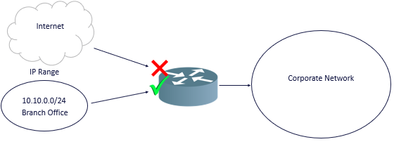
Conditional Access
Previously defined conditions
Examples
Location
Operating System
Device
IP Address
Subnet
This Photo by Unknown Author is licensed under CC BY-SA
Notes:
Time of day restrictions are a conditional access control mechanism

Slide 13
Privilege Access Management (PAM)
Controlling and Monitoring
User with high-level permissions
How the permissions are used
Comprehensive auditing
Internal user activity
External vendor activity
Notes:
File System Permissions
NTFS Permission
Share Permissions

Slide 14
PAM Solutions
Thycotic
CyberArk
Arcon
One Identity SafeGuard
Notes:
https://thycotic.com/
https://arconnet.com/products/privileged-access-management
https://www.cyberark.com/products/privileged-account-security-solution/
https://www.oneidentity.com/one-identity-safeguard/

